Slide 1
Insurance claim analysis: demographic and health factors
Gloria Mompremier

Slide 2
AGENDA
Introduction
Hypotheses
Process & Analysis
Results & Recommendation
Summary

Slide 3
Introduction
The dataset from Kaggle has information on 1300+ patient demographics, including age, gender, BMI, blood pressure, diabetic status, number of children, smoking status, and region
Analyzing these factors across different demographics and geographic areas can provide valuable insights for decision-making about potential customers and targeted public policy support
Overall, this dataset can uncover valuable insights and inform decision-making in various fields

Slide 4
Patient information
Patient ID | 1340 Patient Records
Age | 18 – 60
Gender | Male/Female
BMI(Body Mass Index) | 16 – 53.1
Blood Pressure | 80 - 140
Diabetic | Yes/No
Children | 0 - 5
Smoker | Yes/No
Region | Northwest, Northeast, Southwest, Southeast
Claim | $1120 - $64000

Slide 5
Areas of focus
Patient ID​
BMI​
Diabetic​
Claim​

Slide 6
Research
How does patient demographics affect insurance claims?

Slide 7
hypotheses

Slide 8
BMI & CLAIMS
NULL HYPOTHESIS 1
There is no correlation between patient BMI's and the amount made in insurance claims
ALTERNATIVE HYPOTHESIS 1
There is a significant correlation between patient BMI's and the amount made in insurance claims

Slide 9
Diabetes & CLAIMS
NULL HYPOTHESIS 2
There is no difference in the average amount in insurance claims for patients that have diabetes as opposed to those who do not
ALTERNATIVE HYPOTHESIS 2
There is a significant difference between patients that have diabetes and the amount made in claims as opposed to patients that do not have diabetes

Slide 10
Process & Analysis

Slide 11
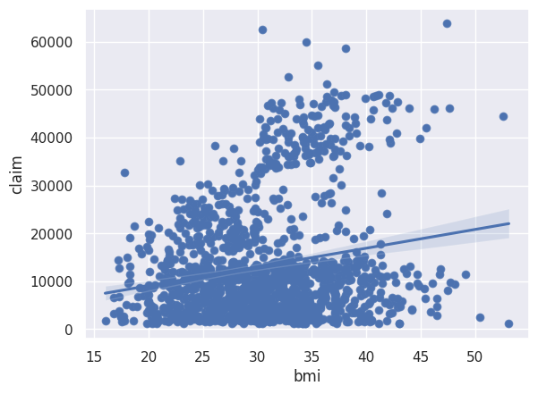
BMI & CLAIMS
Create a scatterplot to see the correlation between patient BMI's and Claims
There is a correlation between BMI's and Claims
Use a Pearson R Test to see statistical significance of BMI's in relation to Claims
Pearson R Results
Statistic=0.19740133652071146
P-value=3.07228503031034e-13

Slide 12
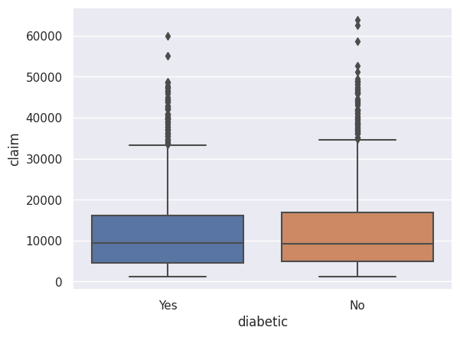
Diabetes & Claims
Use a boxplot to see the correlation of diabetic patients and claims
Patients with diabetes and patients without diabetes average similarly in Claims
Use a T-test to see statistical significance in patients with diabetes and claims
T-test Results
Statistic=-0.3191447336786516
P-value=0.7496665799159533

Slide 13
Results & recommendations

Slide 14
BMI & Claims
RESULTS
REJECT THE NULL HYPOTHESIS
RECOMMENDATION
Pearson R Test
​Statistics:
0.19740133652071146
P-Value:
3.07228503031034e-13
There is a statistically significant relationship between patient BMI and Claims
Offer wellness programs – This can include nutrition education, exercise classes, and gym membership access
Adjust premiums – Although more risky , this can incentivize policyholders to maintain a healthy BMI and reduce the risk of making claims

Slide 15
DIABETES & CLAIMS
RESULTS
FAIL TO REJECT NULL HYPOTHESIS
RECOMMENDATIONS
T-TEST
STATISTICS:
-0.3191447336786516
P-VALUE:
0.7496665799159533
There is not a statistically significant difference in the relationship between patients with and without diabetes and patient claims
Emphasize preventative care – Share the importance for preventative care and regular checkups. This can help policyholders save on future medical expenses
Offer education and support – This can include providing access to supplies and medication, nutritional counseling, and encouraging regular checkups and screenings

Slide 16
SUMMARY
Insurance companies can continue to test various patient demographics to get a better understanding of what affects claims, how they can improve the health outcome of policyholders, and reduce the overall cost of claims. This information can also be helpful in how they market themselves and how they can better support policyholders
For reference:
The Colab notebook is here.

Slide 17
THANK YOU
QUESTIONS

